Slide 1
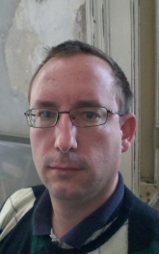

Péter JOLÁNKAI
3rd DEMO
20.10.2017
Pallida Cohort - Static Class
Hardware programing

Slide 2
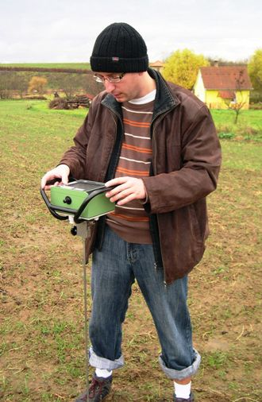
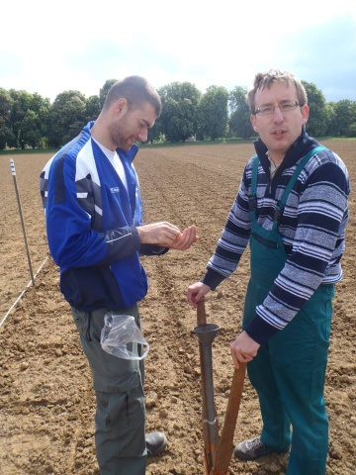
Introduction:
I am an agronomist, with university research background
and lecturing

Slide 3
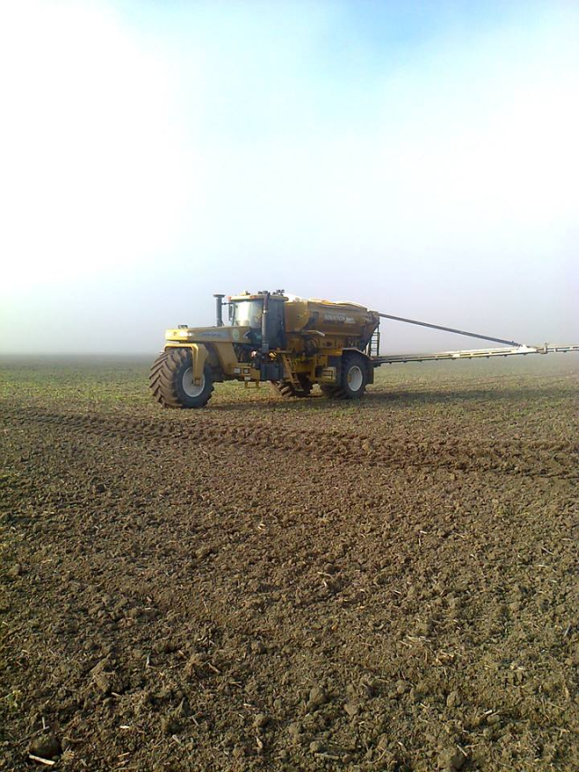

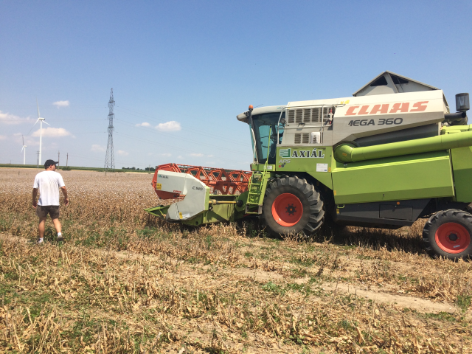
Later I worked for a company
as an agronomist
for producing medical plants

Slide 4
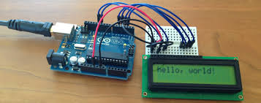
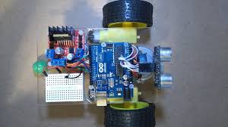
After playing with arduino I decided to join the hardvare
programmer course of Greenfox Academy

Slide 5


Slide 6



C

Slide 7
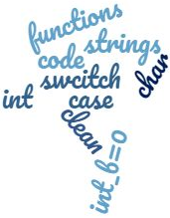

Slide 8
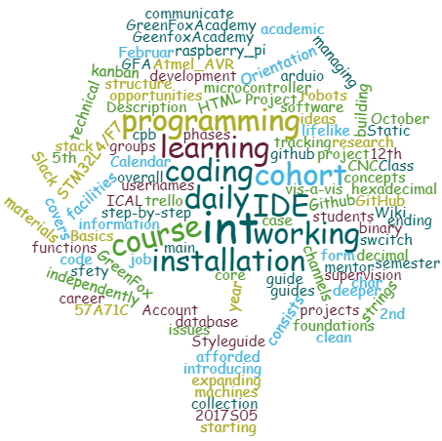

Slide 9
This week activity:
Language C
Parsing and transforming strings
And build a command-line calculator

Slide 10
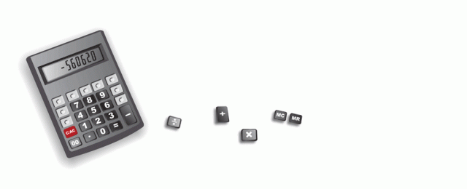
My calculator is not working 100%, some functions are missing, but I am on to fix it.

Slide 11
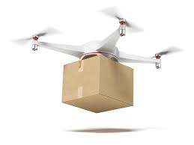
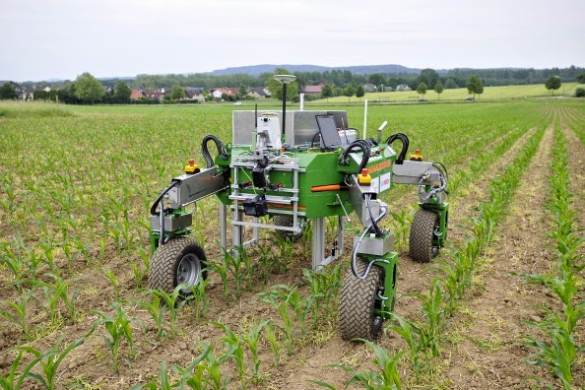
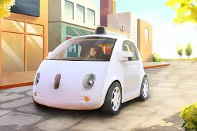
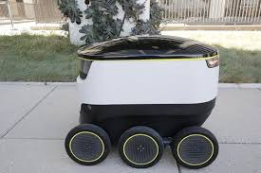
My future goal is to became a plc programmer, and develop robots with many purposes in our future.

Slide 12
Thank you for your attention!

